Slide 1



Slide 2



 | Slope Bins 4 | Smear Count 25
Block number | Alpha w/ Henderson Hasselbalch | Chi Chi_max = 2.2
[0 50] | 0.040012 | 1.160000
[50 75] | -0.278451 | 0.720000
[75 125] | -0.519707 | 0.608000
[125 156] | -0.154453 | 0.529032

Slide 3


 | Slope Bins 4 | Smear Count 31
Block number | Alpha w/ Henderson Hasselbalch | Chi Chi_max = 2.2
[0 31] | 0.001103 | 0.922581
[31 62] | -0.386873 | 0.703226
[62 93] | -0.290146 | 0.967742
[93 496] | 0.037164 | 1.098759
[496 527] | -0.064533 | 0.819355
[527 620] | 0.010682 | 0.756989
[620 647] | -0.103326 | 0.696296

Slide 4
Binary results

Slide 5







For i as L and H:
Pure height profiles
Mixed height profiles
Current L library
Current H library
Skip; marginal increase in vol prob not enough
Move onto chi3.0; larger NFL vol library

Slide 6





All plotting wrong L pure; look only at purp
NFL
NFH
H volume too low to neutralize L (v = 31 nm3/c)

Slide 7







H volume v = 60 nm3/c

Slide 8







H volume too low to neutralize L

Slide 9






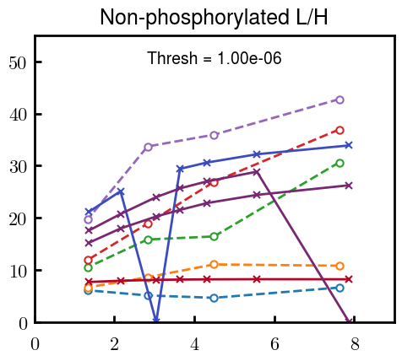


Slide 10
L/H Fitting

Slide 11


Continuation from prev params

Slide 12








Try similar params to H
5.6
11.2
16.8
28
56
7.5
11.25
18.75

Slide 13







v2.7 and some fine
b1.50 v2.7 c3.2
b1.75 v2.7 c3.2
b1.75 v2.5 c3.2
b1.75 v2.5 c3.0
b2.0 v2.7 c3.2
b2.25 v2.7 c3.2
b2.50 v2.7 c3.2
Phi too small to decrease v0

Slide 14










b2.0 v10.0 c3.0
b2.0 v8.0 c3.0
b2.0 v6.0 c3.0
b2.0 v4.0 c3.0
b2.0 v2.0 c3.0
Phi limit
b1.8 v10.0 c3.0
b1.8 v8.0 c3.0
b1.8 v6.0 c3.0
b1.8 v3.0 c3.0
b1.8 v2.0 c3.0
Phi limit

Slide 15





b1.6 v10.0 c3.0
b1.6 v8.0 c3.0
b1.6 v6.0 c3.0
b1.6 v2.0 c3.0
b1.6 v1.5 c3.0
Phi limit

Slide 16


Response to stimuli given composition
Same data
Effect of composition given environment

Slide 17


NFL, pH 7.44, phos 1.5e (locs from LCMS)
Non-phos NFL
Block number | Alpha w/ Henderson Hasselbalch | Chi Chi_max = 3.2
[0 50] | 0.040012 | 1.540000
[50 75] | -0.278451 | 0.960000
[75 125] | -0.519707 | 0.868000
[125 156] | -0.154453 | 0.690323
 | Slope Bins 4 | Smear Count 25
Block number | Alpha w/ Henderson Hasselbalch | Chi Chi_max = 3.2
[0 50] | -0.019988 | 1.540000
[50 75] | -0.278451 | 0.960000
[75 125] | -0.519707 | 0.868000
[125 156] | -0.154453 | 0.690323

Slide 18


NFH, pH 7.44, phos 1.5e (locs from LCMS)
 | Slope Bins 4 | Smear Count 36
Block number | Alpha w/ Henderson Hasselbalch | Chi Chi_max = 3.2 | Chi Chi_max = 3.0
[0 36] | 0.000945 | 1.266667 | 1.20000
[36 72] | -0.527455 | 0.900000 | 0.85000
[72 324] | -0.208376 | 1.729365 | 1.628571
[324 396] | -0.111195 | 1.416667 | 1.333333
[396 432] | -0.152824 | 1.344444 | 1.266667
[432 647] | -0.033955 | 1.077209 | 1.015814

Slide 19

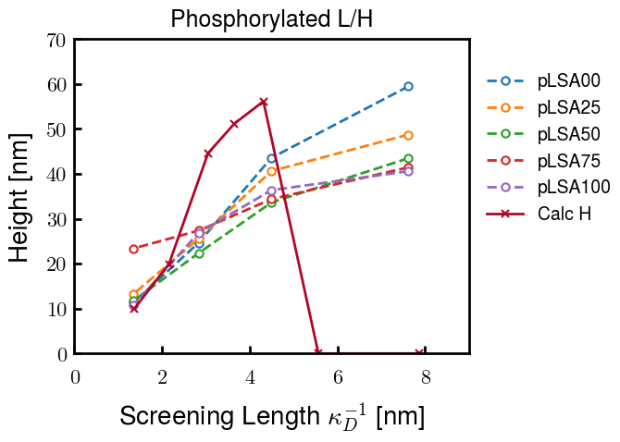
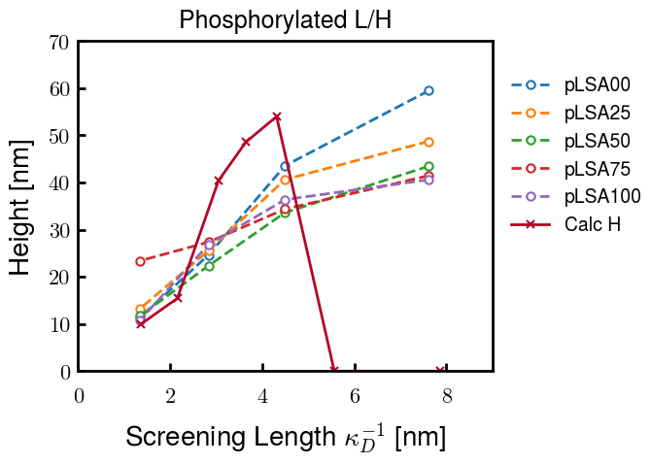
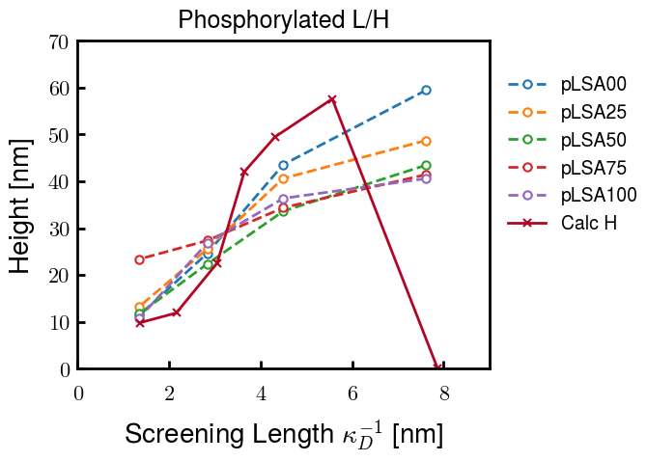
Instead of fitting b/v, could just change value of charge on phos. Try both and see if makes difference for mixture

Slide 20









b2.0 v2.7 c3.2
b3.0 v3.5 c3.5
b3.0 v7.0 c3.5
b3.0 v7.0 c3.0
Phi too small
Phi too small to decrease v0
b4.0 v12.0 c3.0
b5.0 v20.0 c3.0
b5.0 v20.0 c4.0
b5.0 v5.0 c3.0
b5.0 v10.0 c3.0
Phi too small to decrease v0

Slide 21





v20
b5.0 v20.0 c3.0
b4.5 v20.0 c3.0
b4.0 v20.0 c3.0
b3.5 v20.0 c3.0
v10
b5.0 v10.0 c3.0
b4.0 v10.0 c3.0
b3.0 v10.0 c3.0
b2.0 v10.0 c3.0

Slide 22




b2.00 v2.70 c3.20
b2.00 v2.75 c3.20

Slide 23
NFH fitting (from NFL best fit)

Slide 24








b1.00, v0.50, c3.2
b2.00, v4.00, c3.2, th2.5e-02
b1.00, v2.00, c3.2
b1.00, v1.00, c3.2

Slide 25
Mixture

Slide 26



Slide 27


b = 0.75

Slide 28





Slide 29
b = 1.0

Slide 30





Slide 31
b = 1.25

Slide 32




Chi 2.6
Bad vol frac

Slide 33








b25v0
b25v1
b25v2
b25v3

Slide 34




Chi 2.8
Bad vol frac

Slide 35





Slide 36
b = 1.50

Slide 37






Chi 2.8
Bad vol frac

Slide 38





Slide 39

b = 2.00
v4 = 0.25*b^3

Slide 40


Bad vol frac

Slide 41



Slide 42
Fine tune

Slide 43



b1.25, v1.95, c3.0
b1.50, v3.38, c3.0
b2.00, v4.00, c3.0
Norm seems to capture kinked behavior

Slide 44




Slide 45



b1.25, v1.95, c3.2
b1.50, v3.38, c3.2
b2.00, v4.00, c3.2

Slide 46




Slide 47


b1.25
b1.50
b2.00
c2.8
c3.0
c3.2

